Slide 1
Planning for Community Oriented Grids May 26, 2020
Paul De Martini
Executive Director, Pacific Energy Institute
Visiting Scholar, Caltech

Slide 2
“The future has arrived —
it’s just not evenly distributed yet.”
William Gibson

Slide 3
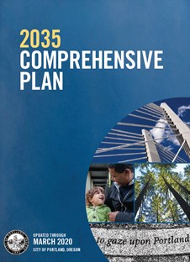
Cities are Taking Action

Slide 4
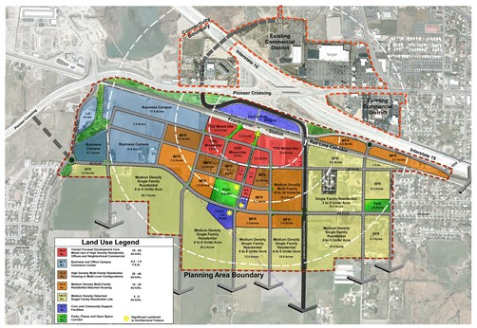
Transit Oriented Development (TOD) concepts are relevant to electric planning
TOD is a design approach employed in connected communities that are improving societal value by:
Improving Quality of Life
Economic Competitiveness
Improving Resilience
Addressing Climate change
These community development efforts typically incorporate energy related elements including:
Transportation Electrification
Critical Infrastructure Resiliency
Local Distributed Resource Development
American Fork, Utah
Source: PSOMAS

Slide 5
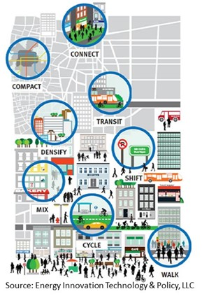
Sustainable & Connected Communities
Building & Transportation Electrification + DER + Grid Platform Enable Connected Communities
Societal value from the creation of Sustainable & Connected Communities accrues in significant part based on the efficient use of clean, resilient electricity
Connected communities in many metro areas will be supplied increasingly in large part by distributed resources (perhaps 35% or more by 2040)
Connected communities will need to be resilient – this will depend in part on microgrids and other customer resources that need to be linked
Connected communities are dependent upon a node-friendly distribution network that is open, visible, flexible, reliable, resilient and safe*
*More Than Smart principle adopted by CPUC

Slide 6
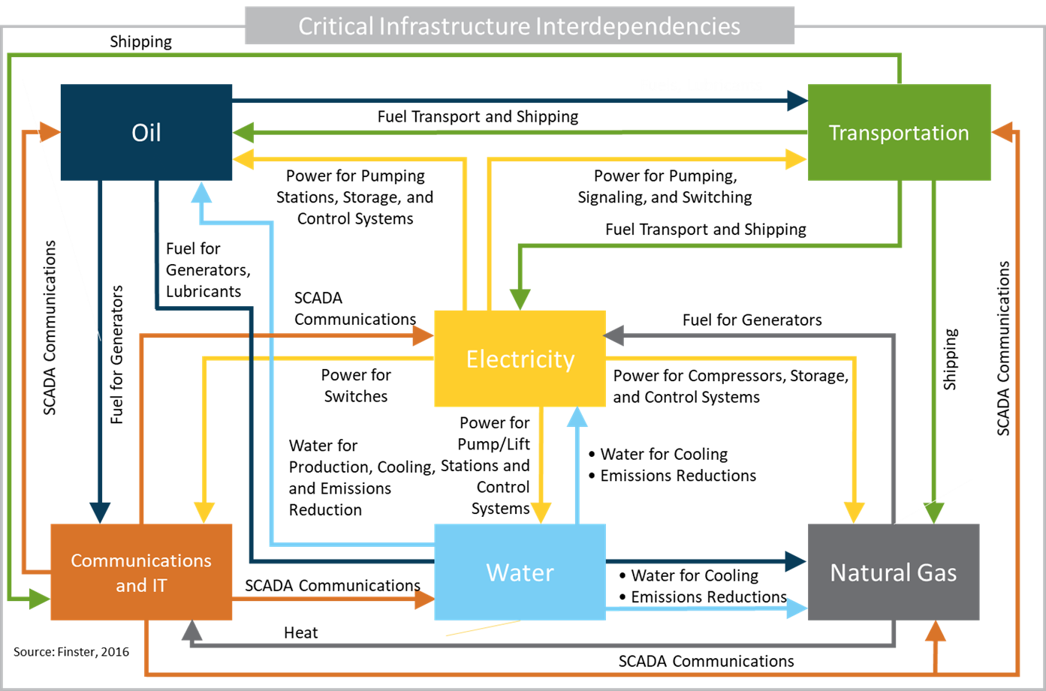
Community Critical Infrastructure Interdependencies
Electrification and distributed resources necessitate closer examination of the interdependencies among critical infrastructure and the distribution grid.
Context: Distribution grids in the United States are on average ~30-years old (of ~40-year asset life), with increasing demands from electrification, large scale adoption of unregulated distributed generation & storage, or use of distributed resources to provide critical grid operational functions. That places significant challenges on a system that was not structured & designed for this new reality.

Slide 7
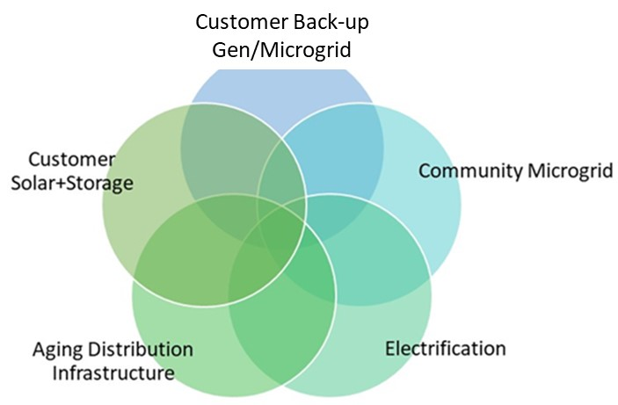
Planning for a Grid 2035
Need to take a more holistic view of “needs” from a local societal perspective
What are counties & cities pursuing?
State regulation and electric system planning tend to lag local climate and sustainable action plans
This lag will become a major issue later this decade as local actions will overtake traditional electric system planning focus and cycles
Understand the desired end state (e.g., Portland 2035)
How is clean electricity used, produced, transported and to whom
What are the “market” overlays that may be needed to enable efficient pricing and use of resources
What is the role of the electric grid in 2035
What are the resilience considerations for such a Y2035 electric ecosystem
Back-cast to today’s starting point and identify the key signposts and associated milestones to evolve toward 2035
Caution to avoid incrementalism in energy policy and solutions that don’t scale leading to cul-de-sacs and political/customer friction
Examples of this dynamic have already occurred in Hawaii, Puerto Rico, California

Slide 8
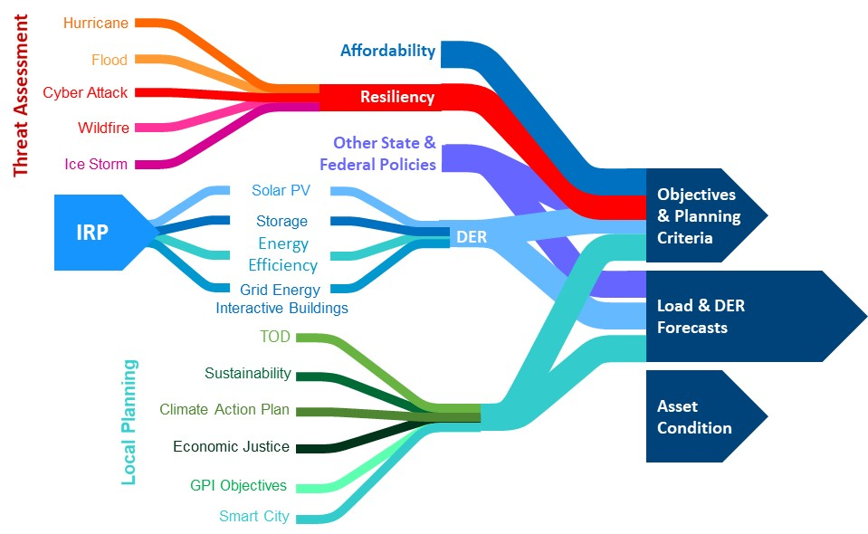
Long-term Distribution Planning
Planning for Grid 2035 requires a more holistic view of needed inputs and criteria – much more explicit inclusion of local policies and action plans
Planning Inputs
Planning Analysis
Resilience
& Reliability
Expansion &
Modernization
Needs Identification
Asset Planning
Source: P. De Martini

Slide 9
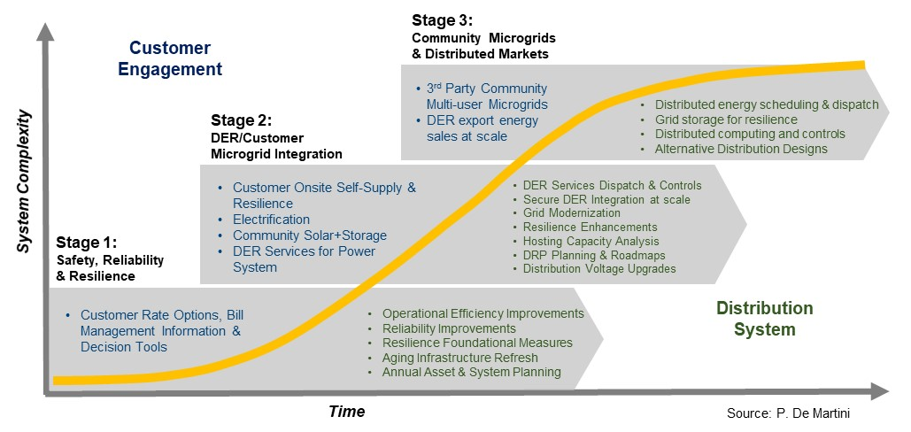
Evolution of Customer/Community & Distribution
What is the scope, scale and pace of change toward a more distributed system?

Slide 10
Electric Transactions 2035?
Already beginning to see this transformation in US electric systems
Wholesale Markets
Independent Generation
Power Traders
Transmission
Owners
RTOs
Distributed Transactions
Distribution
Utility Energy Sales
Competitive Energy Sales
DER Devices Sales
DER/Microgrid Services Aggregators

Slide 11
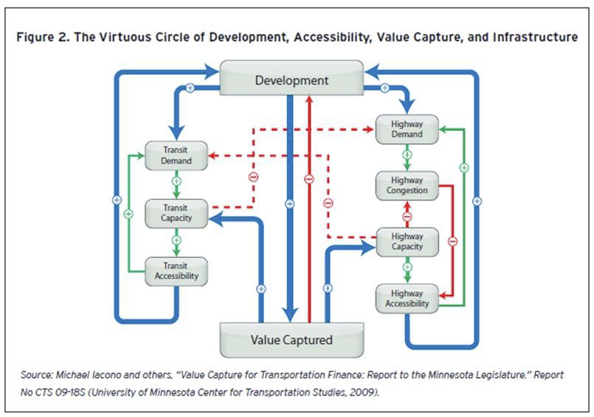
Transportation Network Characteristics
Adapting Transportation Concepts for Sustainable & Connected Communities
Connectivity: Connectivity refers to the density of connections in path or road networks, capacity and directness of links.
Accessibility: Accessibility refers to market access measured through statistical indicators of effective market size or effective market density and ease of access.
Availability: Availability refers to a transportation system's performance to deliver services when demanded.

Slide 12
Distribution Network Criteria
California’s highly distributed electric system will need to address these criteria

Slide 13
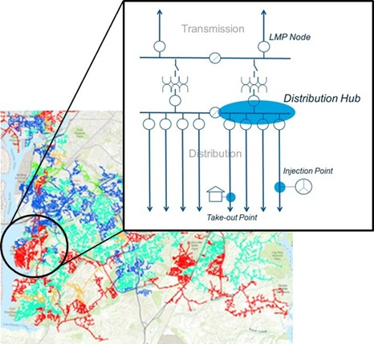
Transactive Distribution Grid Design Concept
Distribution transactions
Create transaction “hub” at low-side of T-D Substation transformer bank, associated distribution bus section and feeders
Distribution transactions are scheduled for delivery to and from this “hub” via corresponding injection and take-out points on interconnected circuits
Injection Point – Physical location at which scheduled power is injected into distribution system
Take Out Point – Physical location of the recipient of energy from the scheduled power.
Distribution to transmission transactions
Interchange scheduling point is the associated LMP node on high side of substation transformer bank.

Slide 14
Distribution Grid as a Network Platform
Electric Distribution Network Value Can Be Super Linear
Metcalfe’s Law: Value of a network grows at the square of the number of connections – not applicable to electric grids
Geoffrey West: With each increase in size, cities get a super-linear value-add of 15% in increased efficiency and productivity.
De Martini-ICF: Increases in DER, electrified buildings and EVs (number of grid connections) create super-linear societal value - findings consistent with West’s “Scale” research
Distribution Network Value
Accumulated Network Value
Societal Value
Traditional Linear Value based on Electric Sales
Connections

Slide 15
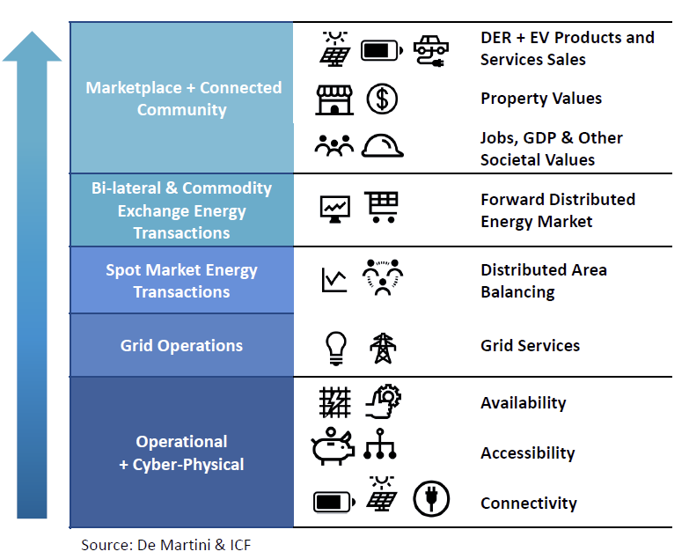
Distribution Network Value Potential
Realizing the value potential requires a different mental model
The cyber-physical grid infrastructure can provide the foundation for network value creation
Total value increases through the interdependent capabilities of each value layer
Higher electrification and DER adoption drives value
Capturing benefits requires a broader view of the solution set and deliberate alternative grid designs & investment to support value realization

Slide 16
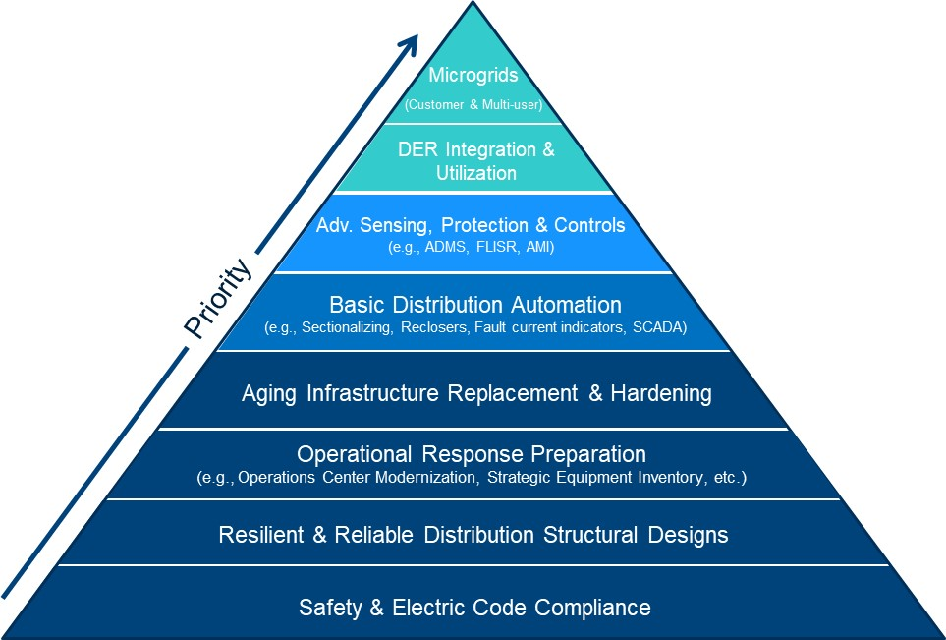
Distribution System Planning
Multiple community & utility distribution planning efforts often involved – need to converge to ensure optimal grid investments & non-utility solutions
County & City Planning
Grid Modernization
Resilience
& Reliability
Asset Planning

Slide 17
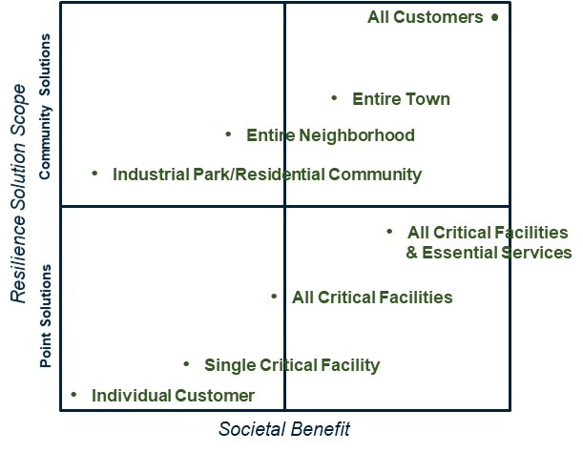
Determining Portfolio of Resilience Solutions
Proactive, collaborative approach required to align state, local and customer needs
Challenge – communities, utilities, 3rd parties and customers are each independently pursuing various point & community solutions
Community: Cyber-Physical Grid Hardening, Mini-grids, Multi-user Microgrids, etc.
Point Solutions: Back-up generation, energy storage, customer microgrid, etc.
Specific solutions don’t necessarily solve all the needs – a portfolio is needed
Solutions usually address specific functional resilience needs
Solutions have different potential societal benefits based on type of event and severity
How to determine an effective portfolio?

Slide 18
A Future History of the Grid Many possible futures – essential to consider the potential implications
DER Integration
Grid as
a Platform
Resilience
Transactive Energy
DER Centric
Integrated Distributed Planning
NWA Utilization
Smart Grid
Interconnection Rules
Enabling Grid
Electrification
ZNE Adoption
DER for Resource Adequacy
Grid Modernization
TDC Operational Coordination
Community:
Environmental & Nation State Threats
Critical facilities and essential services
Neighborhood
Grid Structural Design Changes
Customer:
Point Solutions
Multi-user MGs
Retail Energy Market:
Post-NEM - Buy-Sell Contracts with Customers w/DER
Subscription pricing for customers
System Operations:
Energy storage greatly dampens stochasticity
Zero marginal cost resources reduce LMP effectiveness
Local utilization of DER changes wholesale market
2010-2030
2015-2035
2030-2040

Slide 19
Considerations for Grid 2035
Future architecture of community dominant transactive distributed power systems will be influenced by connected, resilient community development employing transit-oriented development (TOD) designs.
Technological advancement is accelerating and there will be new and larger societal impacts from emergent technologies over the next decade as seen over the past 10+ years
Large scale use of DER for resource adequacy will fundamentally change the design requirements for distribution grid
A community oriented grid (COG) architecture would inform electricity market designs, grid investments, operational coordination (including interoperability) and public policy shaping DER adoption.
Role and value of electric grid to enable clean, electrified & resilient communities is not fully understood by all stakeholders
Shift from scarcity thinking to abundance thinking regarding the significant value potential created from grid investment?

Slide 20
“The future belongs to those who prepare for it today.” Malcolm X
https://pacificenergyinstitute.org/

